Slide 1
MACHINE LEARNING
college To corporate

Slide 2
What Is Machine Learning?
Machine Learning is the science (and art) of programming computers so they can learn from data
Without data machine learning is possible ?

Slide 3
TERMS USED IN ML
Features are like the details we look at, while labels are the answers or categories we're trying to find based on those details.

Slide 4
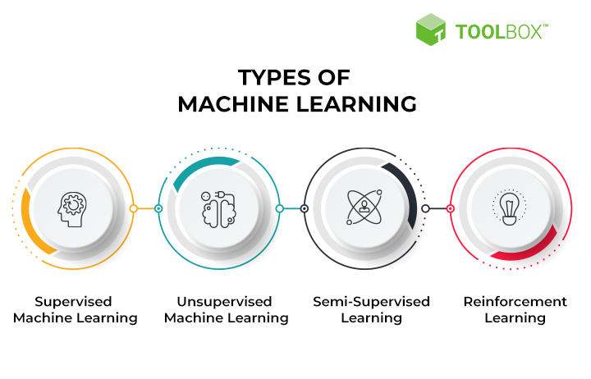


Types of ML

Slide 5
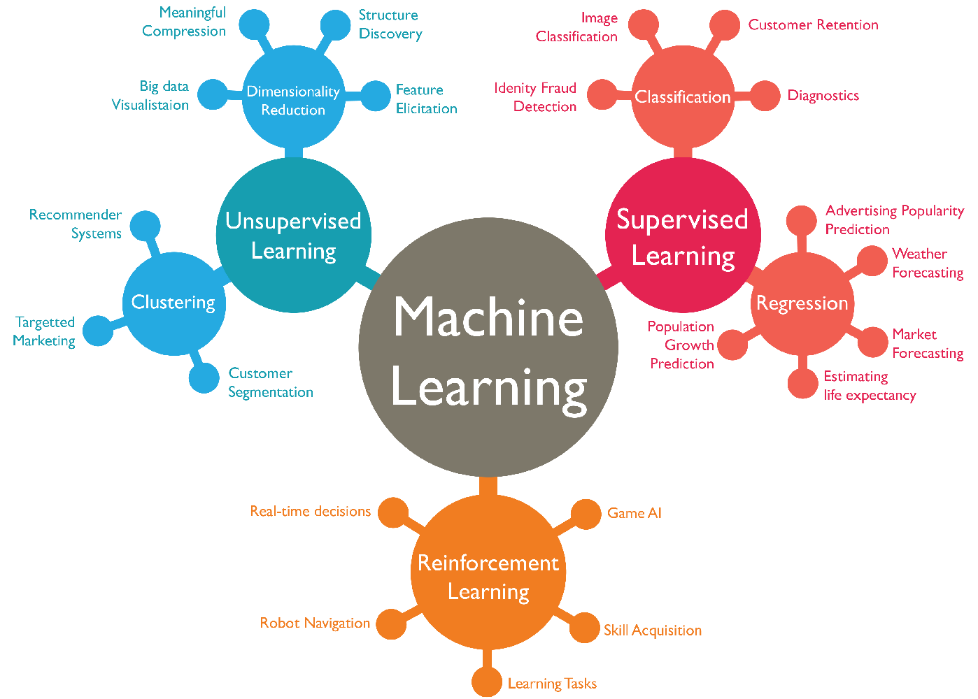

Slide 6
SUPERVISED LEARNING
In supervised learning, the training data you feed to the algorithm includes the desired solutions, called labels
Supervised learning generally includes two main types:
Classification: In classification, the goal is to predict a categorical label or class for each data point. For example, classifying emails as spam or not spam, or classifying images of handwritten digits into their respective numbers.
Regression: In regression, the goal is to predict a continuous numerical value for each data point. For instance, predicting house prices based on features like size, location, and number of bedrooms.

Slide 7
ALGORITHM USED IN SUPERVISED LEARNING
k-Nearest Neighbors
Linear Regression
Logistic Regression
Support Vector Machines (SVMs)
Decision Trees and Random Forests
Neural network
NOTE : some regression algorithms can be used for classification as well, and vice versa. For example, Logistic Regression is commonly used for classification, as it can output a value that corresponds to the probability of belonging to a given class (e.g., 20% chance of being spam).

Slide 8
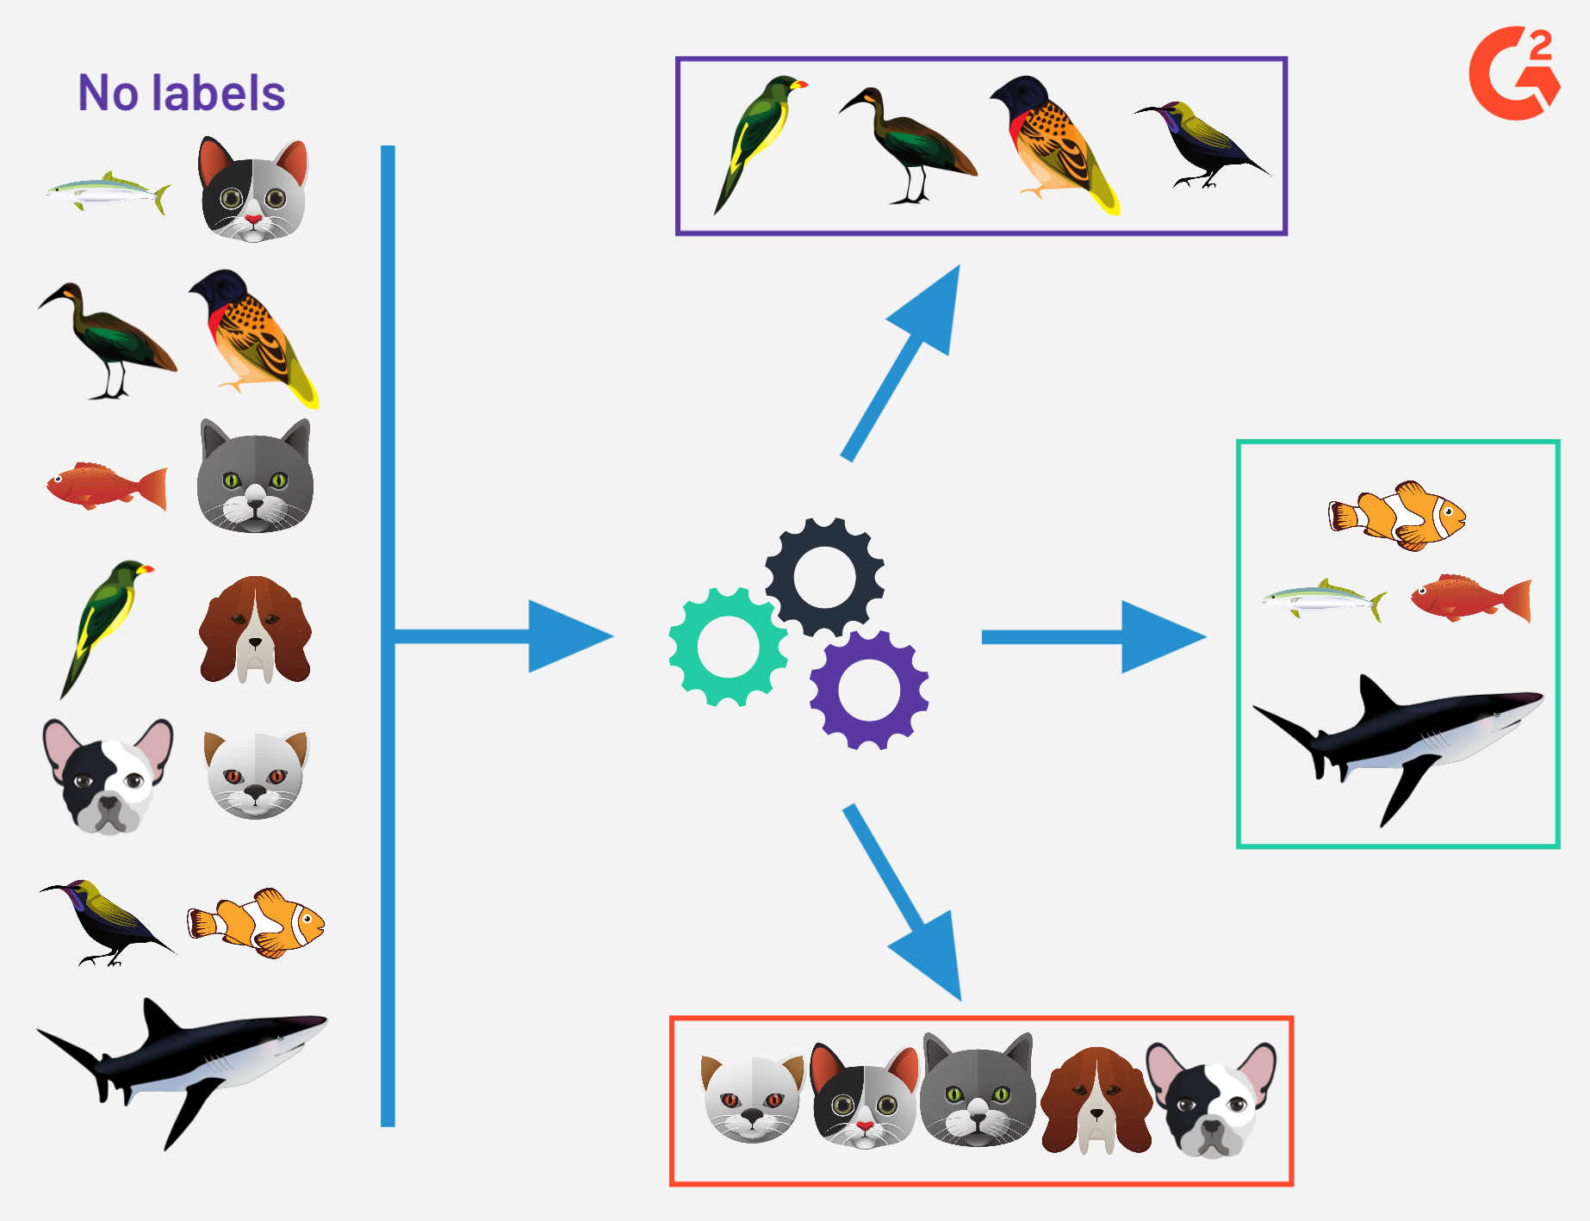
Unsupervised learning
In unsupervised learning, as you might guess, the training data is unlabeled The system tries to learn without a teacher.

Slide 9
ALGORITHM USED IN UNSUPERVISED LEARNING
Clustering —K-Means —DBSCAN —Hierarchical Cluster Analysis (HCA)
Anomaly detection and novelty detection —One-class SVM —Isolation Forest
Visualization and dimensionality reduction —Principal Component Analysis (PCA) —Kernel PCA —Locally-Linear Embedding (LLE) —t-distributed Stochastic Neighbor Embedding (t-SNE)
Association rule learning —Apriori —Eclat

Slide 10
CLUSTRING
Clustering is the process of grouping similar data points together based on their characteristics or features, without predefined categories or labels.
Anomaly detection and novelty detection
anomaly detection—for example, detecting unusual credit card transactions to prevent fraud, catching manufacturing defects, or automatically removing outliers from a dataset before feeding it to another learning algorithm. The system is shown mostly normal instances during training, so it learns to recognize them and when it sees a new instance it can tell whether it looks like a normal one or whether it is likely an anomaly A very similar task is novelty detection: the difference is that novelty detection algorithms expect to see only normal data during training, while anomaly detection algorithms are usually more tolerant, they can often perform well even with a small percentage of outliers in the training set.

Slide 11
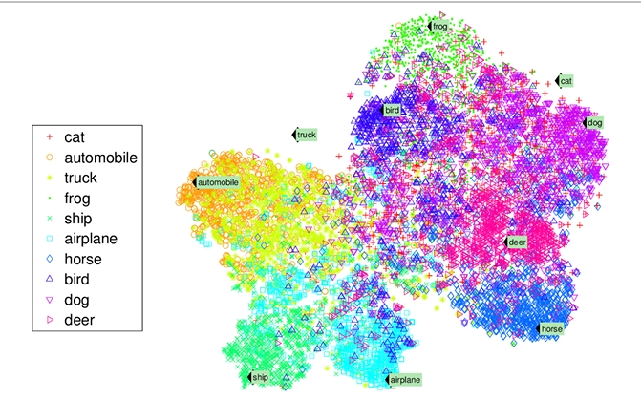
Visualization and dimensionality reduction
Visualization is representing complex data in a graphical format for easier interpretation
dimensionality reduction, in which the goal is to simplify the data without losing too much information. One way to do this is to merge several correlated features into one. For example, a car’s mileage may be very correlated with its age, so the dimensionality reduction algorithm will merge them into one feature that rep resents the car’s wear and tear. This is called feature extraction.
NOTE : Visualization algorithms are also good examples of unsupervised learning algorithms

Slide 12
Association rule learning
association rule learning, in which the goal is to dig into large amounts of data and discover interesting relations between attributes.
EXAMPLE
Let's say you have a dataset of transactions from a grocery store, where each transaction lists the items purchased by a customer.
One association rule that could be discovered from this data might be:
"If a customer buys bread, they are likely to also buy butter."
This association rule indicates a relationship between two items commonly purchased together. It could help the store in various ways, like placing butter near the bread aisle to increase sales.

Slide 13
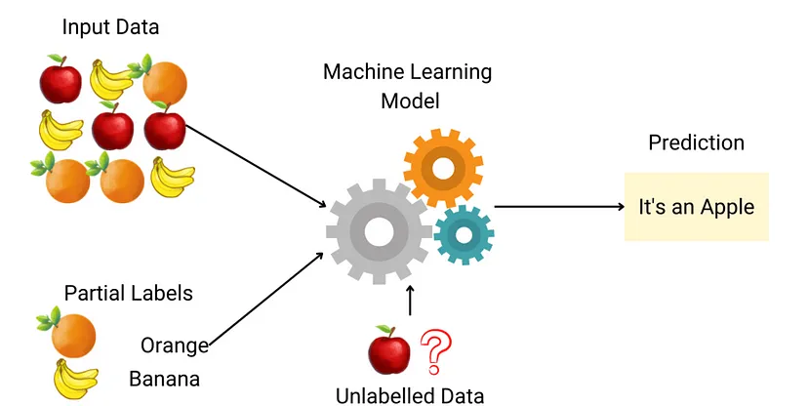
Semi Supervised Learning
Some algorithms can deal with partially labeled training data, usually a lot of unlabeled data and a little bit of labeled data. This is called semisupervised learning
EXAMPLE : Some photo-hosting services, such as Google Photos, are good examples of this. Once you upload all your family photos to the service, it automatically recognizes that the same person A shows up in photos 1, 5, and 11, while another person B shows up in photos 2, 5, and 7. This is the unsupervised part of the algorithm (clustering). Now all the system needs is for you to tell it who these people are. Just one label per person and it is able to name everyone in every photo, which is useful for searching photos.

Slide 14
ALGORITHM USED IN SEMISUPERVISED LEANRING
Most semisupervised learning algorithms are combinations of unsupervised and supervised algorithms. For example, deep belief networks (DBNs)

Slide 15
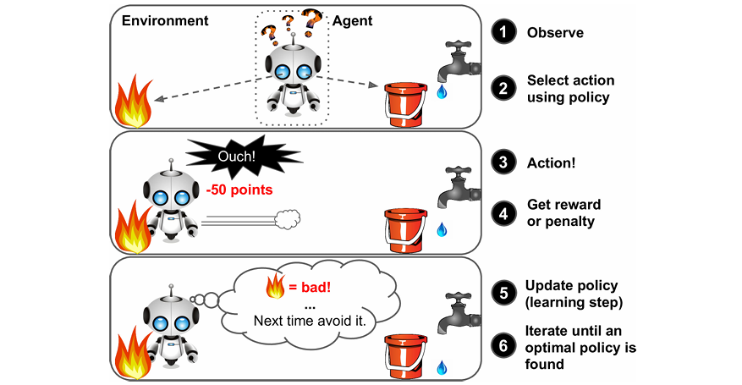
Reinforcement Learning
Reinforcement Learning is a very different beast. The learning system, called an agent in this context, can observe the environment, select and perform actions, and get rewards in return (or penalties in the form of negative rewards, as in It must then learn by itself what is the best strategy, called a policy, to get the most reward over time. A policy defines what action the agent should choose when it is in a given situation.

Slide 16
Reinforcement Learning
For example, many robots implement Reinforcement Learning algorithms to learn how to walk. DeepMind’s AlphaGo program is also a good example of Reinforcement Learning: it made the headlines in May 2017 when it beat the world champion Ke Jie at the game of Go. It learned its winning policy by analyzing millions of games, and then playing many games against itself. Note that learning was turned off during the games against the champion; AlphaGo was just applying the policy it had learned.

Slide 17
Algorithms Used In Reinforcement Learning
1. Q-Learning
2. Deep Q-Networks (DQN)
3. Policy Gradient methods
4. Deep Deterministic Policy Gradient (DDPG)
5. Proximal Policy Optimization (PPO)
6. Actor-Critic methods
7. Monte Carlo Tree Search (MCTS)
8. Temporal Difference (TD) Learning
These algorithms form the backbone of many successful applications of reinforcement learning in various domains, such as gaming, robotics, and autonomous systems.

